Slide 1

Predicting COVID-19 Illness Severity & Death Amongst Hospitalized Patients
Gayle Ferguson
IOD Data Science & AI Capstone Project
August 2022
Notes:
Hi, I’m Gayle Ferguson and today I will be presenting my project on predicting illness severity and death from admission data of hospitalized COVID19 patients

Slide 2

COVID-19 is responsible for a 6.43M deaths worldwide since early 2020 and, as new variants emerge and spread, will continue to be a healthcare problem.
For most people, the disease is ‘mild’ and does not require hospitalisation.
However, in a significant portion of patients the disease is severe and fatal.
Determining which patients are at high risk of severe illness or mortality is essential for clinical decision-making and ensuring sometimes scarce resources are prioritised for those who need them most.
Goal: To predict COVID-19 severe illness and/or mortality from demographics, comorbidity and admission laboratory tests
Notes:
COVID-19 first emerge in late 2019 and has been responsible for a large number of deaths worldwide.
Though the disease is mild for many, this is not the case for all.
Predictive modelling is needed in order to allow hospitals to best manage resources by identifying and triaging the most vulnerable individuals.

Slide 3


The Dataset
4711 instances
- 1st and 2nd 3-weeks of the pandemic
- Clinical Looking Glass [CLG]; Streamline Health, Atlanta, Georgia
82 features:
- age, ethnicity, length of stay (9)
- comorbidities(16)
- admission test results (57)
Targets (SL, classification):
- death (0/1)
- severity (0-11)
Source: https://www.kaggle.com/datasets/harshwalia/mortality-risk-clinincal-data-of-covid19-patients
Notes:
The dataset I used comes from the earliest six weeks of the pandemic, from a medical care facility in Atlanta Georgia and uploaded to Kaggle.
It contains data on demographics, comorbidities and admission tests for 4711 patients, and contains 82 features.
This is a supervised machine learning, classification problem. The targets I’ve identified for prediction are ‘death vs recovery’ and ‘severity of illness’.

Slide 4
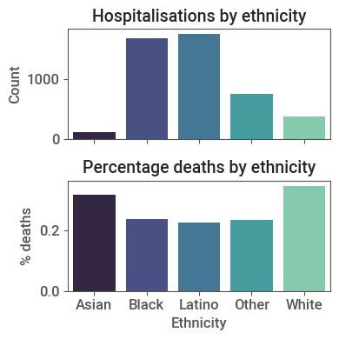
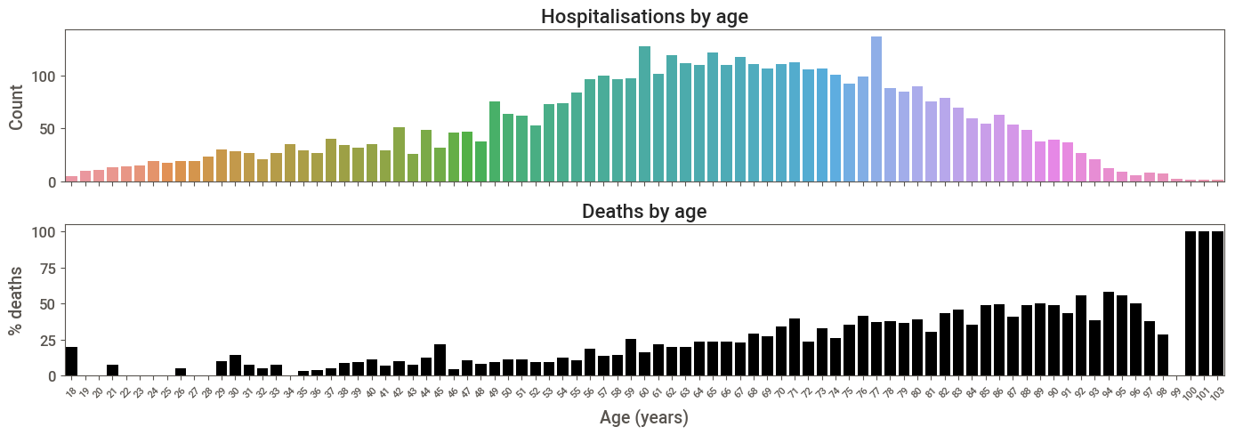
Demographic Insights:
Hospitalised individuals were predominantly over 50
Deaths were disproportionately among older people
Hospitalizations were disproportionately Black or Latino, though a greater proportion of White and Asian patients died
40
50
60
70
80
Notes:
First, a quick look at the patient demographics:
The majority were over 50 and of either ‘Black’ or ‘Latino’ ethnicity.
Interestingly, the proportion of deaths were greater for the White and Asian patients.
Deaths increased with age, with a significant proportion of hospitalised people over 70 not surviving.

Slide 5
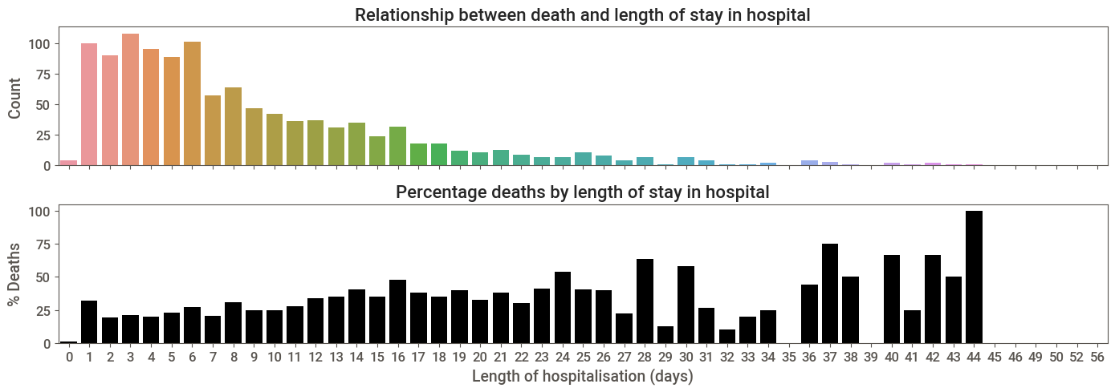
Most hospital stays were less than 2 weeks.
A greater proportion of deaths occurred amongst those who stayed over a month in hospital.
Distribution of hospitalisation time
Most were in the hospital for less than two weeks…
Percentage deaths by hospitalisation length
…but a greater proportion of patients died after longer stays
Notes:
Most people stayed less than 2 weeks in hospital: about 25% of these died and the rest recovered and were discharged.
Very few stayed beyond a month is hospital but, of these, a much larger proportion ultimately died.

Slide 6
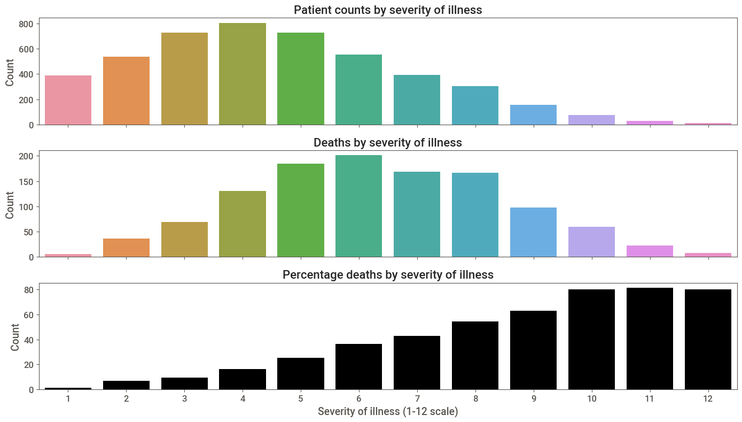
% Death is clearly correlated with severity of illness
Distribution of illness severity
Count
Death counts as a function of illness severity
Count
Death proportions as a function of illness severity
% death
Notes:
Counts by severity are more or less normally distributed, at least at the left end, with most patients experiencing ‘severity’ of a scale of 3-5.
Of those that died, most experienced severity of 5-8.
Almost all patients experiencing severity 10-12 died.

Slide 7
Comorbidities
16 features – mostly binary categorical
1. Myocardial Infarction (MI) (0/1)
2. Peripheral Vascular Disease (PVD) (0/1/2)
3. Congestive Heart Failure (CHF) (0/1)
4. Cardiovascular Disease (CVD) (0/1)
5. Dementia (0/1)
6. Chronic obstructive pulmonary disease (COPD) (0/1)
7. Diabetes mellitus complicated (0/1)
8. Diabetes mellitus simple (0/1)
9. Renal Disease (0/1)
10. All CNS (0/1)
11. Pure CNS (0/1)
12. Stroke (0/1)
13. Seizure (0/1)
14. Old - Syncope (0/1)
15. Old – Other Neurological Conditions (0/1)
16. Other Brain Lesions (0/1)
Notes:
For those who are interested, here is the list of comorbidities.
Almost all of these were scored as ‘Yes/No’ – ”has the patient suffered this condition”?
Includes things like heart attack, dementia, diabetes and stroke.

Slide 8
Clinical Tests
Continuous measures
Categorical data
O₂ Saturation
Temperature
Mean Arterial Pressure (MAP)
D-dimer
Platelet count
International Normalized Ratio (INR)
Blood Urea Nitrogen (BUN)
Creatinine
Sodium
Glucose
Aspartate aminotransferase (AST)
12. Alanine transaminase (ALT)
13. White Blood Cell (WBC) counts
14. Lymphocytes
15. Interleukin-6 (IL6)
16. Ferritin
17. C-Reactive Protein
18. Procalcitonin
19. Troponin
20. O₂ Saturation < 94% (0/1)
21. Temperature > 38 ºC (0/1)
22. MAP < 70 mmHg (0/1)
23. D-Dimer > 3 mg/ml (0/1)
24. Platelet score (0/1/2)
25. INR > 1.2 (0/1)
26. BUN > 30 mg/dL (0/1)
27. Creatinine Score (0/1/2)
28. Sodium < 139 or > 155 mEq/L (0/1)
29. Glucose < 60 or > 500 mg/dL (0/1)
30. AST > 40 units/L (0/1)
31. ALT > 40 units/L (0/1)
32. WBC < 1.8 or > 4.8 × 10⁹/L (0/1)
33. Lymphocytes < 1 per nL (0/1)
34. IL6 > 150 pg/ml (0/1)
35. Ferritin > 300 ng/mL (0/1)
36. C-Reactive Protein > 1 mg/L (0/1)
37. Procalcitonin > 0.1 ng/ml (0/1)
38. Troponin > 0.1 ng/ml (0/1)
Notes:
We started with 38 basic features from the clinical test data.
Most of these are blood tests that indicate liver, kidney, blood clotting function, and immune function.
Direct measures on the left are continuous.
These were then used to produce binary classifiers based on clinically-relevant thresholds on the right.

Slide 9
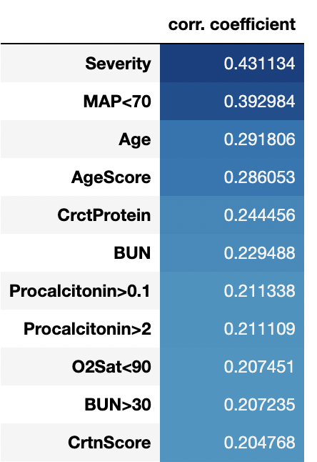
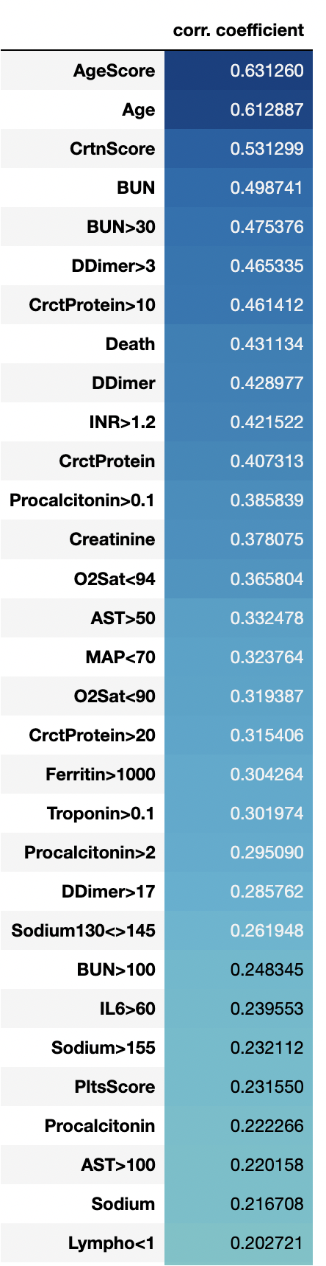
Pearsons Correlation
with ‘Death’
with ‘Severity’
Notes:
Features that correlated well with death were few, and the correlation coefficients not high.
Severity, low Blood Pressure and Age are the most notable.
Many more features correlated significantly with Severity.
Again Age us a crucial factor, but also Creatinine, blood urea nitrogen, and d-dimer. These indicate kidney function and blood clot clearance activity.

Slide 10
4.
Models:
K-Nearest Neighbours
Naïve Bayes
Logistic Regression
SVC
Random Forest
XGBoost
Stacking Classifier
Workflow
Data Cleaning
Identification of mismatches between columns and other errors
Replacement of ‘0’ values with mode or median values
1.
3.
Dimension reduction
PCA
Dataset 1
(60 PC’s)
Feature Engineering
Adjustment of thresholds for some existing features
Creation of new binary features based on published normal ranges for blood test data
Reduced the ‘severity’ (target) categories from 12 to 4
2.
Dataset 2
(Top 10)
Recursive Feature Elimination (RFE)
Dataset 3
(Top 40)
Feature selection
Select K Best (SKB)
Dataset 4
(Top 10)
Dataset 5
(Top 40)
Notes:
A large amount of time was spent cleaning the data, which was problematic and riddled with errors, but I won’t bore you with the details!
We carried out feature engineering, identifying more clinically relevant thresholds and binary scoring patients for these.
We then carried out dimension reduction and feature selection to produce cut-down datasets, with different combinations of features and treatments of the data.
These were then used to tune, fit and evaluate a range of classification models.

Slide 11
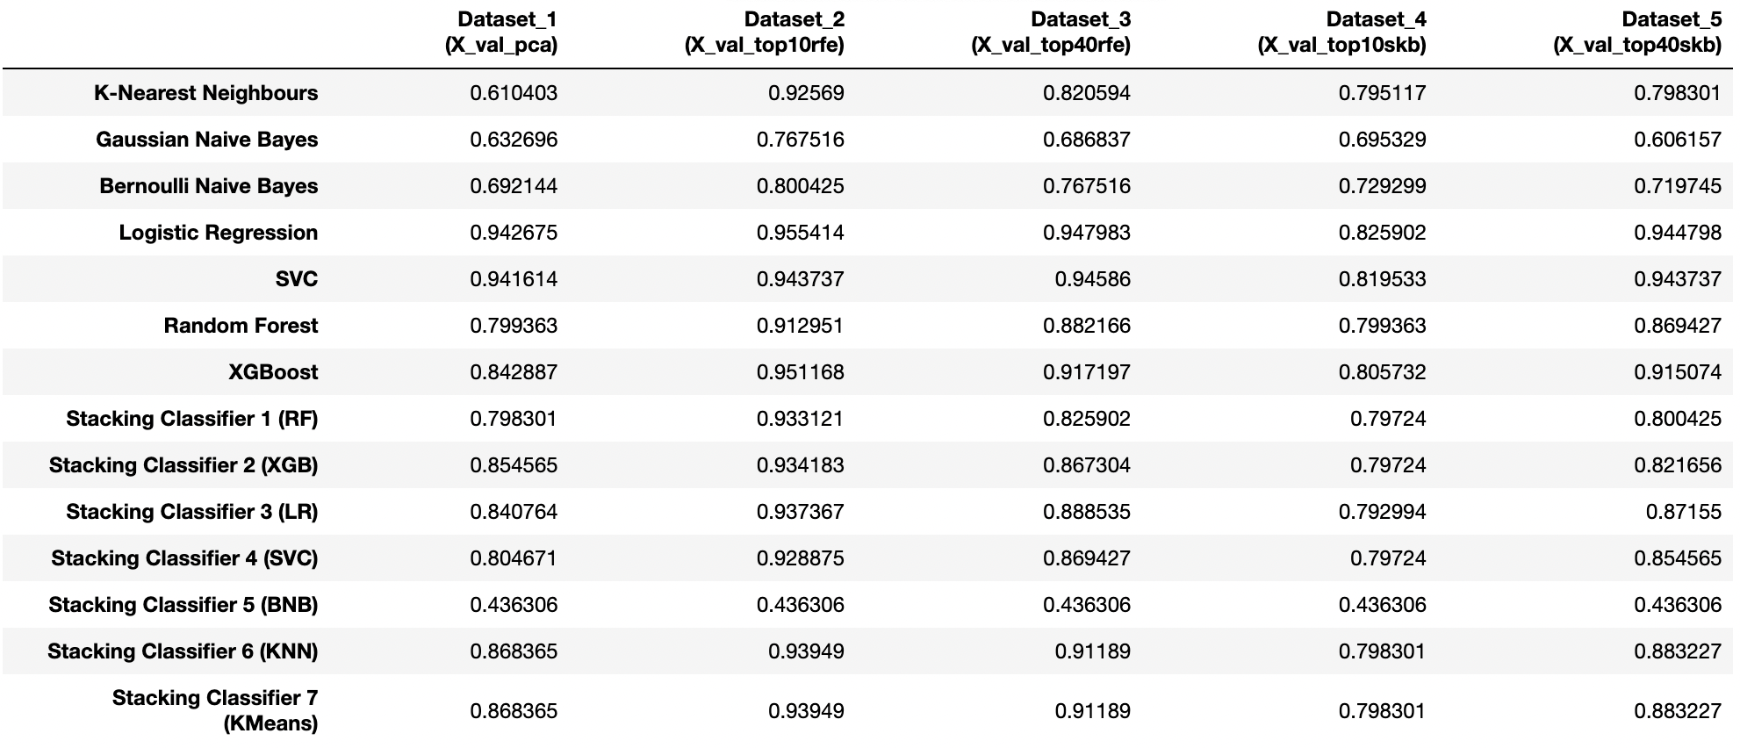
Results
Logistic Regression, XGBoost and SVC models predicted ‘severity’ class with 94-95% accuracy
Predicting ‘Severity’
Dataset 1
(60 PC’s)
Dataset 2
(Top 10 - RFE)
Dataset 3
(Top 40 - RFE)
Dataset 4
(Top 10)
Dataset 5
(Top 40)
Notes:
These are the results – a table of accuracy scores.
I’ve highlighted the best results here.
Logistic Regression, XGBoost and SV.C models predicted ‘severity’ class with over 94% accuracy.
Note that the best performing dataset had only 10 features, picked by recursive feature elimination.

Slide 12
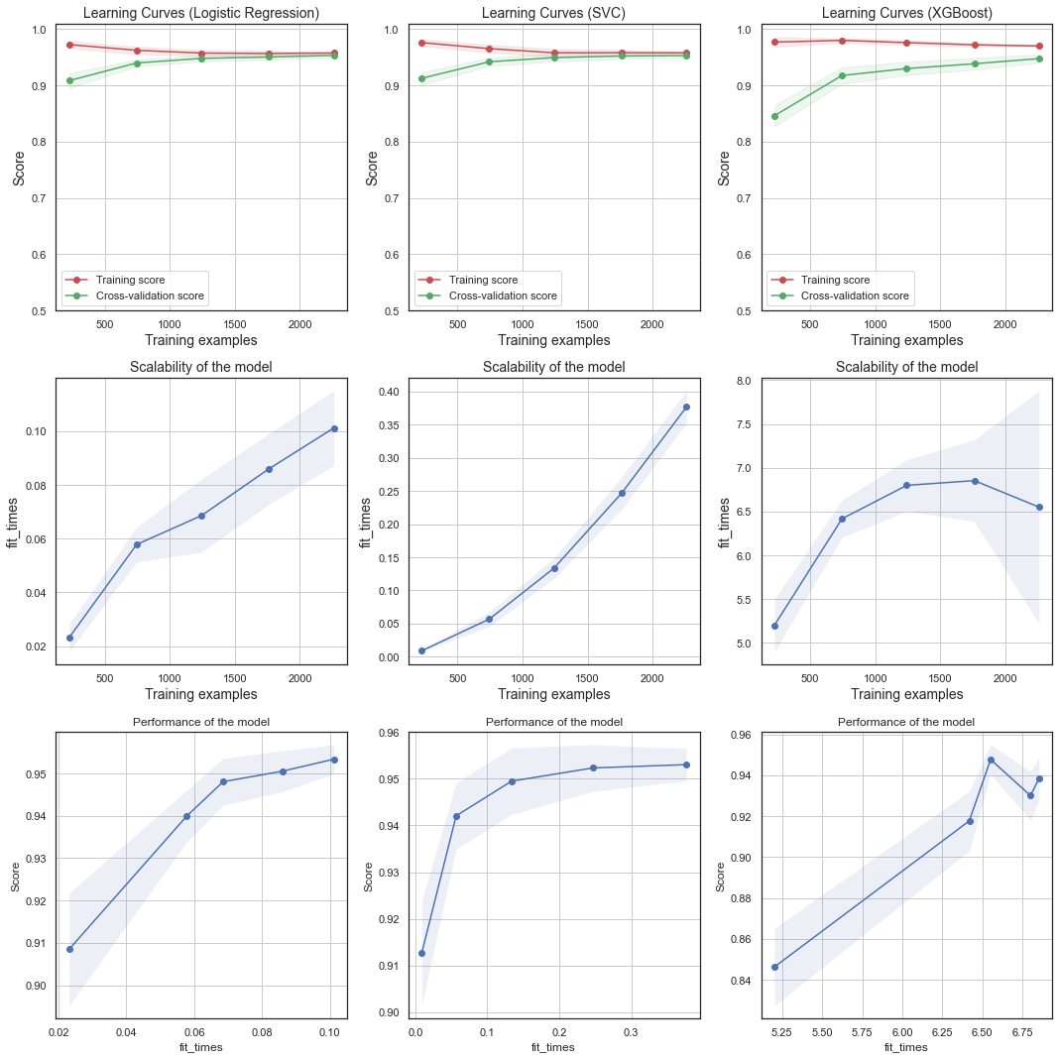
Evaluation
Fine-tuning produced models with >95% accuracy
Convergence of training and cross-validation scores over training samples of increasing size indicates that the models are not over-fitting
Logistic Regression
SVC
XGBoost
Accuracy 0.9554
Accuracy 0.9544
Accuracy 0.9512
Notes:
After further fine-tuning, these are the results for the best three models.
There is good convergence of training and cross-validation scores, showing that these models are not overfitting.
XGBoost will probably do better on a larger dataset, but I don’t believe it is over-fitting.

Slide 13
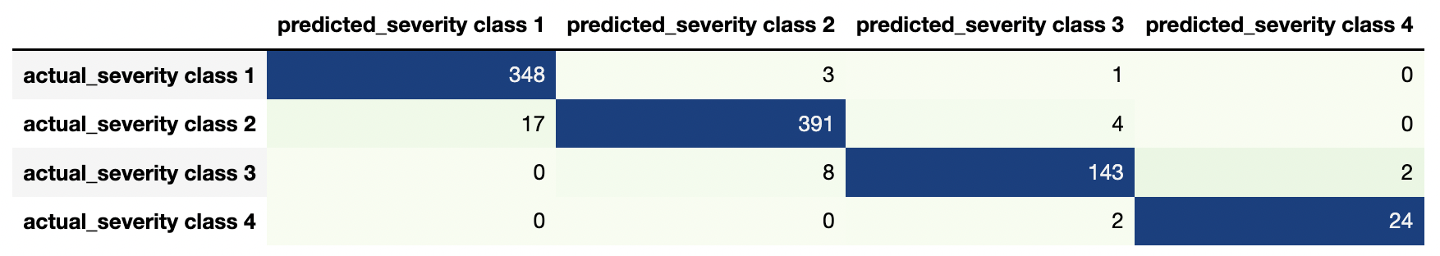
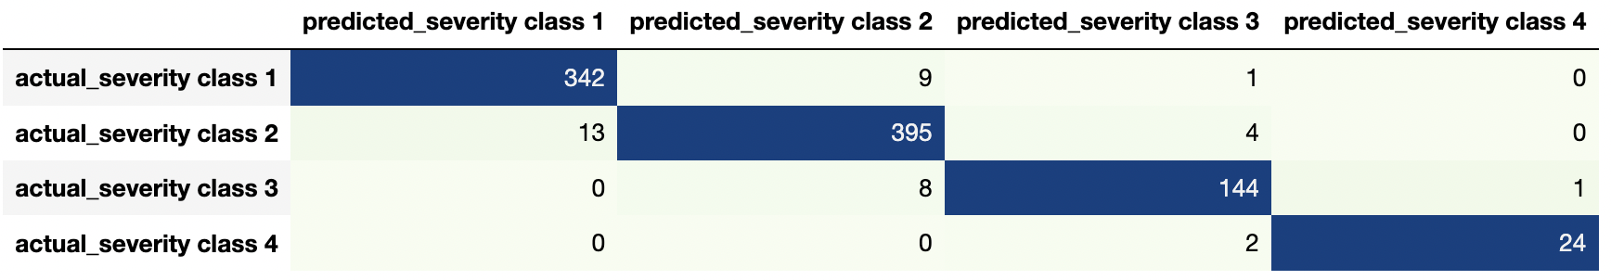
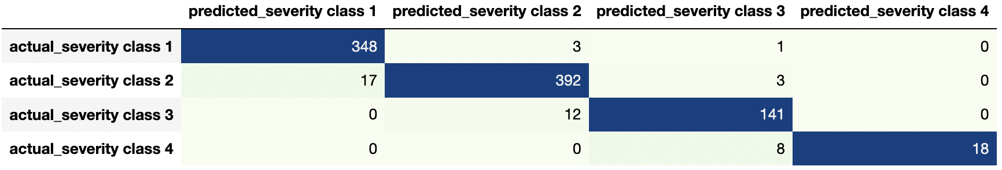
LogReg and SVC models perform similarly:
only 2 “misses” for Class 4 and 8 “misses” for Class 3
XGBoost produces a greater number of “misses” for the more severe classes
Evaluation
LogReg
SVC
XGB
Notes:
Confusion matrices allow us to evaluate the models for recall and precision.
All three are very similar.
But if we highlight the ‘misses’, we see that Logistic Regression and SVC out-perform XGBoost, which is under-predicting more often, i.e. predicting a lower class of severity than actual, which is what we want to avoid when identifying the patients in most need of triage.

Slide 14
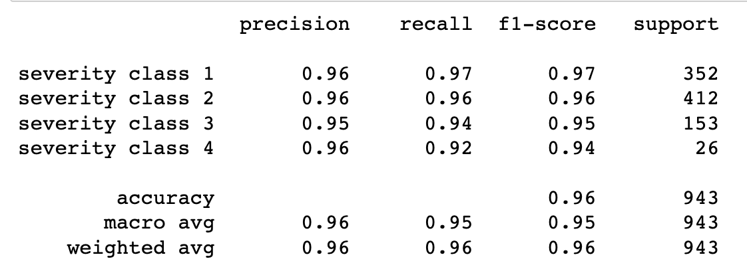
Evaluation
The SVC model gave slightly better precision and recall for classes 3 and 4 than the other two models
TP/(TP+FP)
TP/(TP+FN)
1- precision = “false alarms”
1-recall = “misses”
SVC
Notes:
The winning model, and the one I recommend it SVC and it does the best for both precision and accuracy.
Still missing 8% of the most severe class, but these were predicted just one class below.

Slide 15
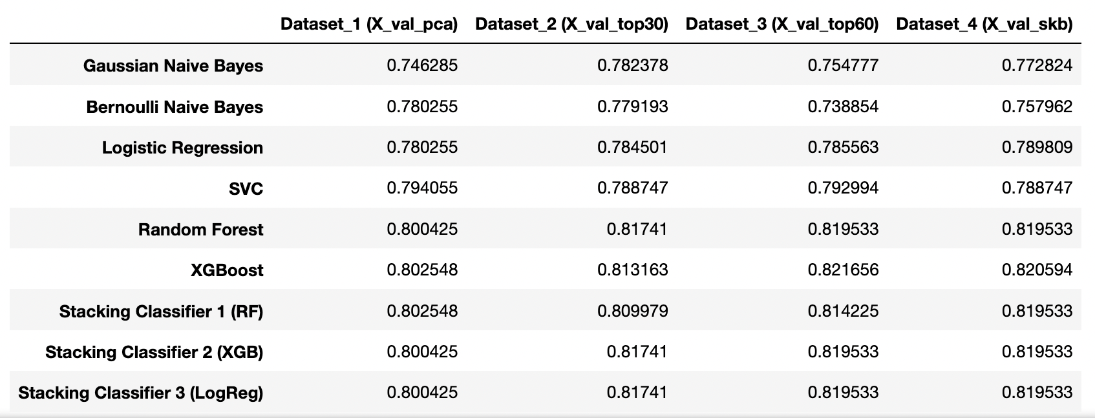
Baseline accuracy is 73%
(i.e. we’d we correct 73% of the time by always predicting that the patient will survive!)
Results
Random Forest and XGBoost models were the best performers, but only 9% better than the baseline at best
Predicting ‘Death’
Dataset 1
(60 PC’s)
Dataset 2
(Top 30 - RFE)
Dataset 3
(Top 60 - RFE)
Dataset 4
(Top 30 - SKB)
Notes:
If time permits I’ll report briefly on my less successful prediction of death.
Here the baseline is already 73%, which is our accuracy if we simply predicted that everyone would recover.
The best models do only 9% better than the baseline.

Slide 16
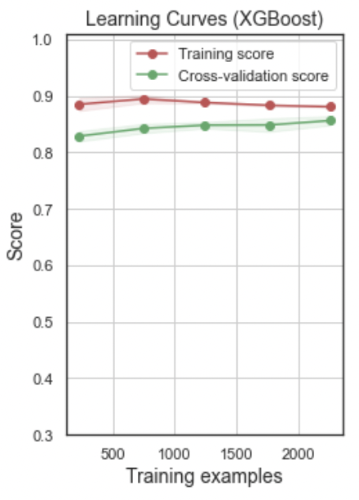
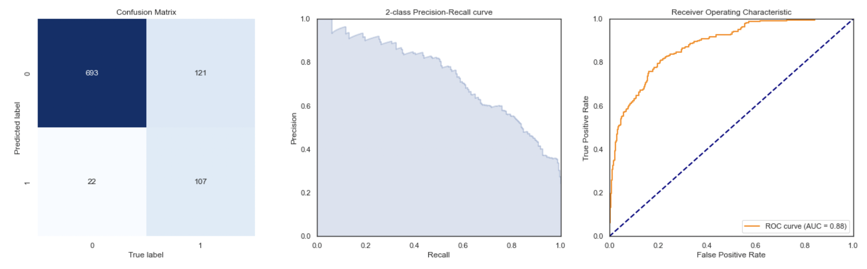
Evaluation of XGBoost Model
Learning Curves
Predicting ‘Death’
Dataset 3 (Top 60 - RFE)
Recall is especially poor,
i.e. more than 50% of ‘deaths’ are wrongly predicted as ‘survived’
X_test
Accuracy: 0.8484
Precision: 0.8295
Recall: 0.4693
Confusion Matrix
2-Class Precision-Recall Curve
ROC Curve
survived
693
121
Predicted label
Precision
True Positive Rate
died
22
107
AUC = 0.88
survived
died
True label
Recall
False Positive Rate
Notes:
Here is the evaluation for the best model, XGBoost, and you can see that its biggest weakness is recall.
Although accuracy is 84%, more than 50% of deaths are being “missed”.

Slide 17
Conclusions
Top 10 Predictors of ‘Severity’ (by RFE)
Mean Arterial Pressure < 70 mmHg
International Normalized Ratio (INR) > 1.2
C-reactive Protein > 10 mg/L
D-Dimer > 3 mg/mL
Platelet Score
Age Score
O₂ Saturation < 94%
Aspartate aminotransferase (AST) > 50 u/L
Creatinine Score
Temperature <= 36 ºC
SVC model can predict ‘severity’ of illness (4 classes) with > 95% accuracy and precision, and recall of 92%, and is easily scalable
Predicting ‘death’ is less accurate, with > 50% “misses”; further data examination is needed to identify the cause of prediction error
Notwithstanding, accurate prediction of severe illness will enable hospitals to triage the most vulnerable patients, preventing many deaths
Notes:
So in conclusion, we can predict the severity of illness with over 95% accuracy using the SVC model, which is readily scalable.
But further work is needed to improve the prediction of death.
Notwithstanding, accurate prediction of severe illness will enable hospitals to triage the most vulnerable patients, preventing many deaths

Slide 18
The End

Slide 19
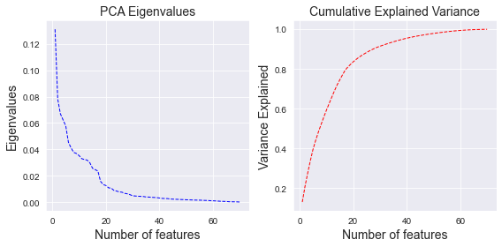
Explained Variance and Cumulative Explained Variance after dimension reduction by PCA
Predicting ‘Severity’

Slide 20
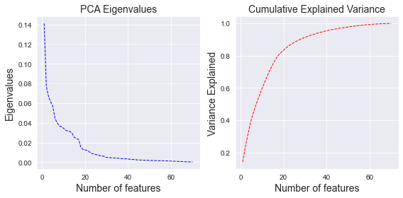
Explained Variance and Cumulative Explained Variance after dimension reduction by PCA
Predicting ‘Death’

Slide 21
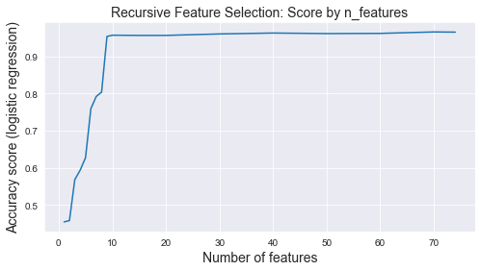
Recursive Feature Elimination for Predictors of Illness ‘Severity’

Slide 22
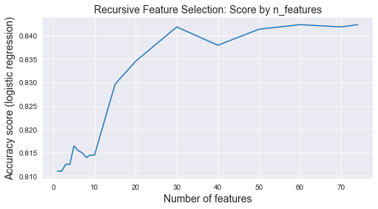
Recursive Feature Elimination for Predictors of ‘Death’

Slide 23
Scalability of the models for Predicting ‘Severity’
Logistic Regression
SVC
XGBoost

Slide 24
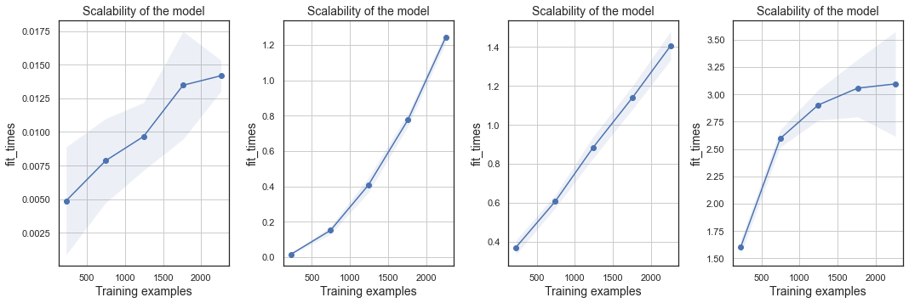
Scalability of the models for Predicting ‘Death’
Logistic Regression
SVC
Random Forest
XGBoost

Slide 25
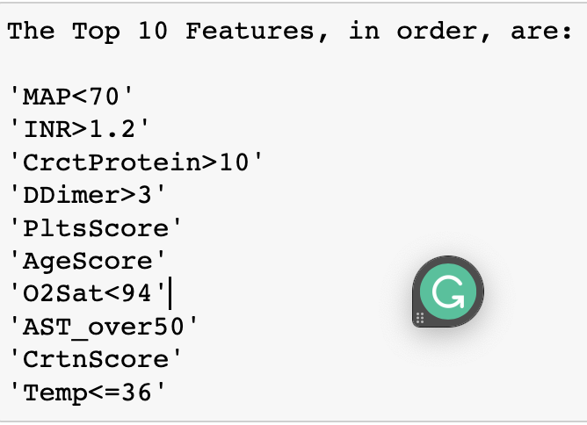
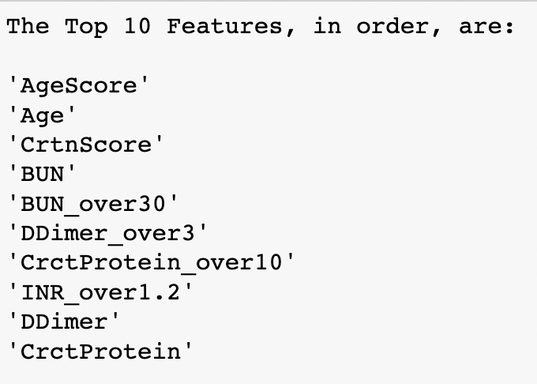
Top10 features for predicting illness severity by RFE (left) and SKB (right)

Slide 26
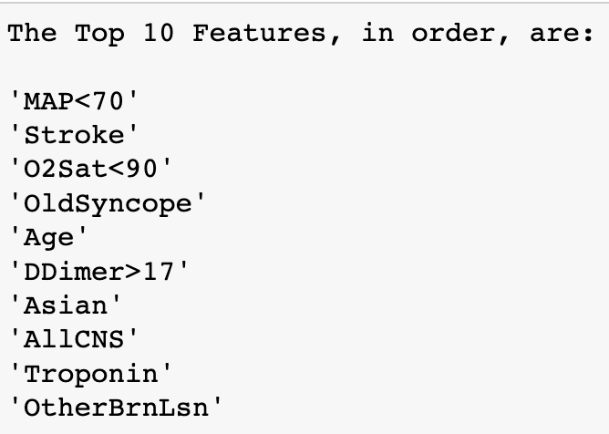
Top10 features for predicting illness severity (left) and death (right) by RFE

